Slide 1


Presentation on Online Movie Ticket Booking System
Group Members
Darshan Deosale-233030
Akash Patil-233007
Project Guide :
Mrs.Sonali Mogal

Slide 2
Introduction
The Movie Ticket Booking System project aims to revolutionize the way moviegoers book their tickets by providing a seamless and user-friendly online platform.
Our system will cover a wide range of functionalities, such as movie selection to seat reservation .
In an era driven by digital solutions, our project addresses the need for convenient and efficient movie ticket booking

Slide 3
Objectives
Streamline the ticket booking process for customers.
Reduce manual work for theater staff through automation.
Enhance the overall user experience.
Improve theater management and reporting capabilities

Slide 4
Features
User Registration and Login
Movie Listings and Showtimes
Seat Selection and Reservation
Admin Dashboard for Theater Management
Ratings and Reviews , Feedback and support

Slide 5
System Architecture
Frontend: User interface for customers and theater staff.
Backend: Handles business logic and interacts with the database.
Database: Stores user data, movie details, seat availability, and booking information.
Technologies used : such as HTML/CSS, JavaScript, React, ,mySQL etc.

Slide 6
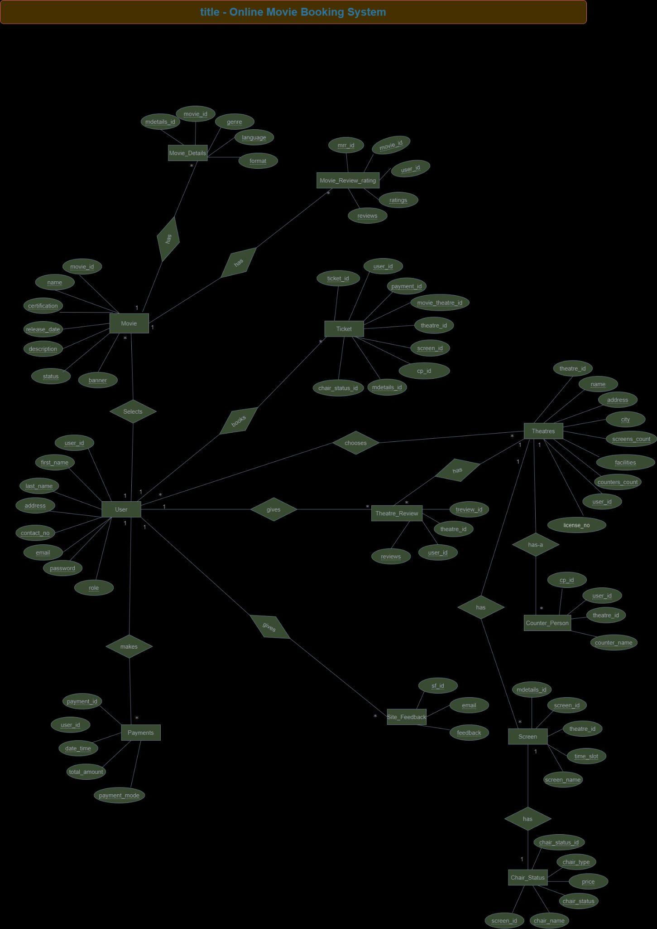
ER Diagram

Slide 7
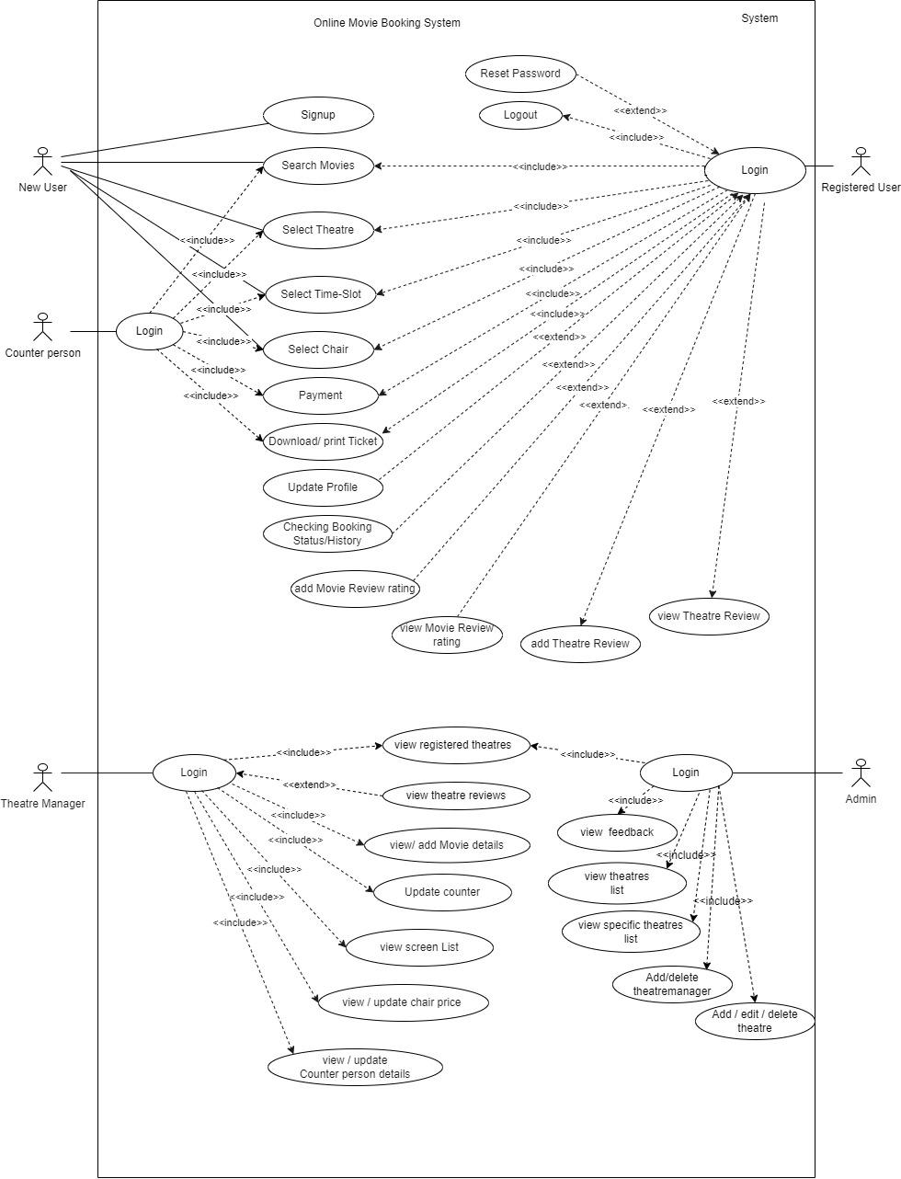
Use Case Diagram

Slide 8
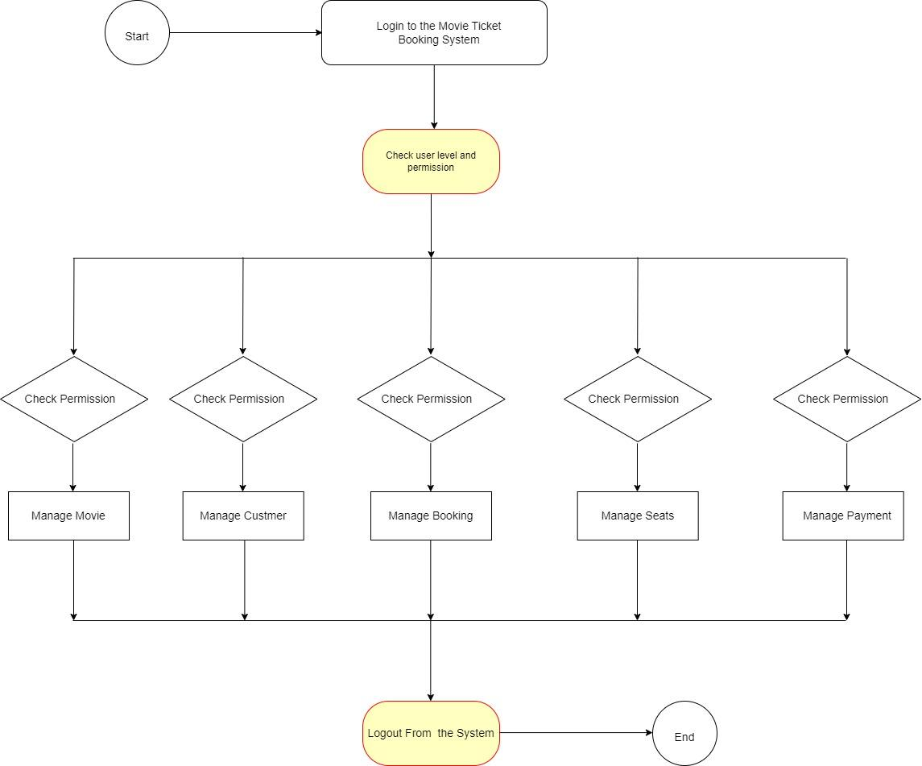
Activity

Slide 9
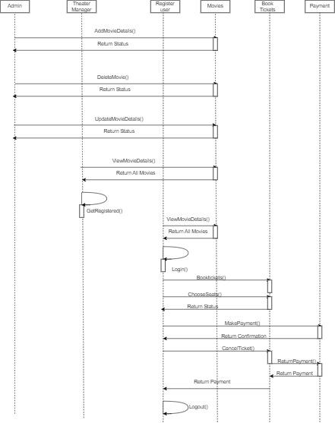
Sequence diagram

Slide 10
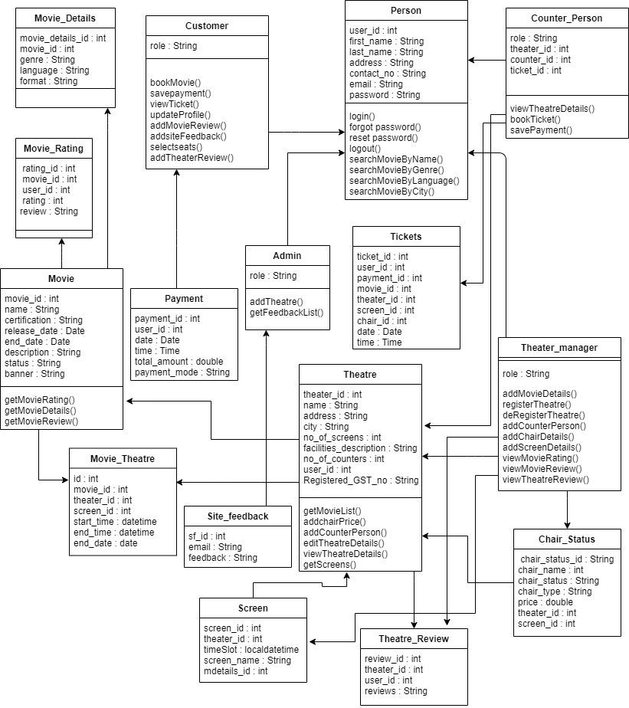
Class Diagram

Slide 11
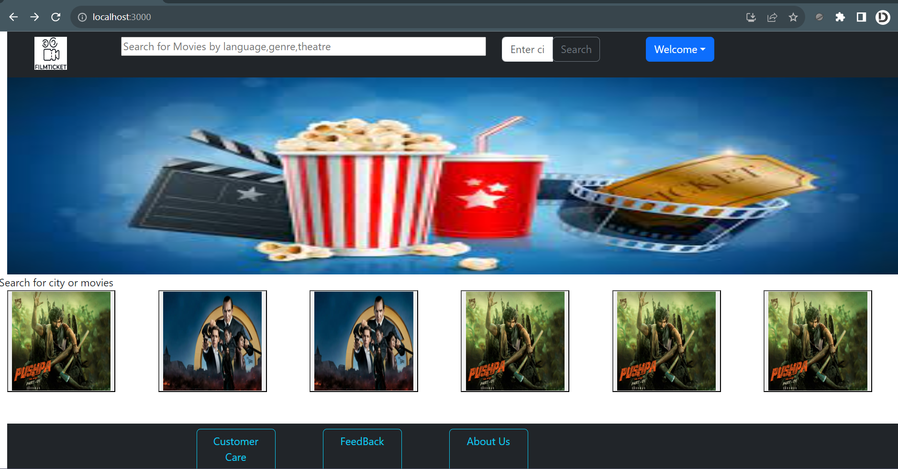
System Overview-User Flow
Customers browse a list of available movies and showtimes.

Slide 12
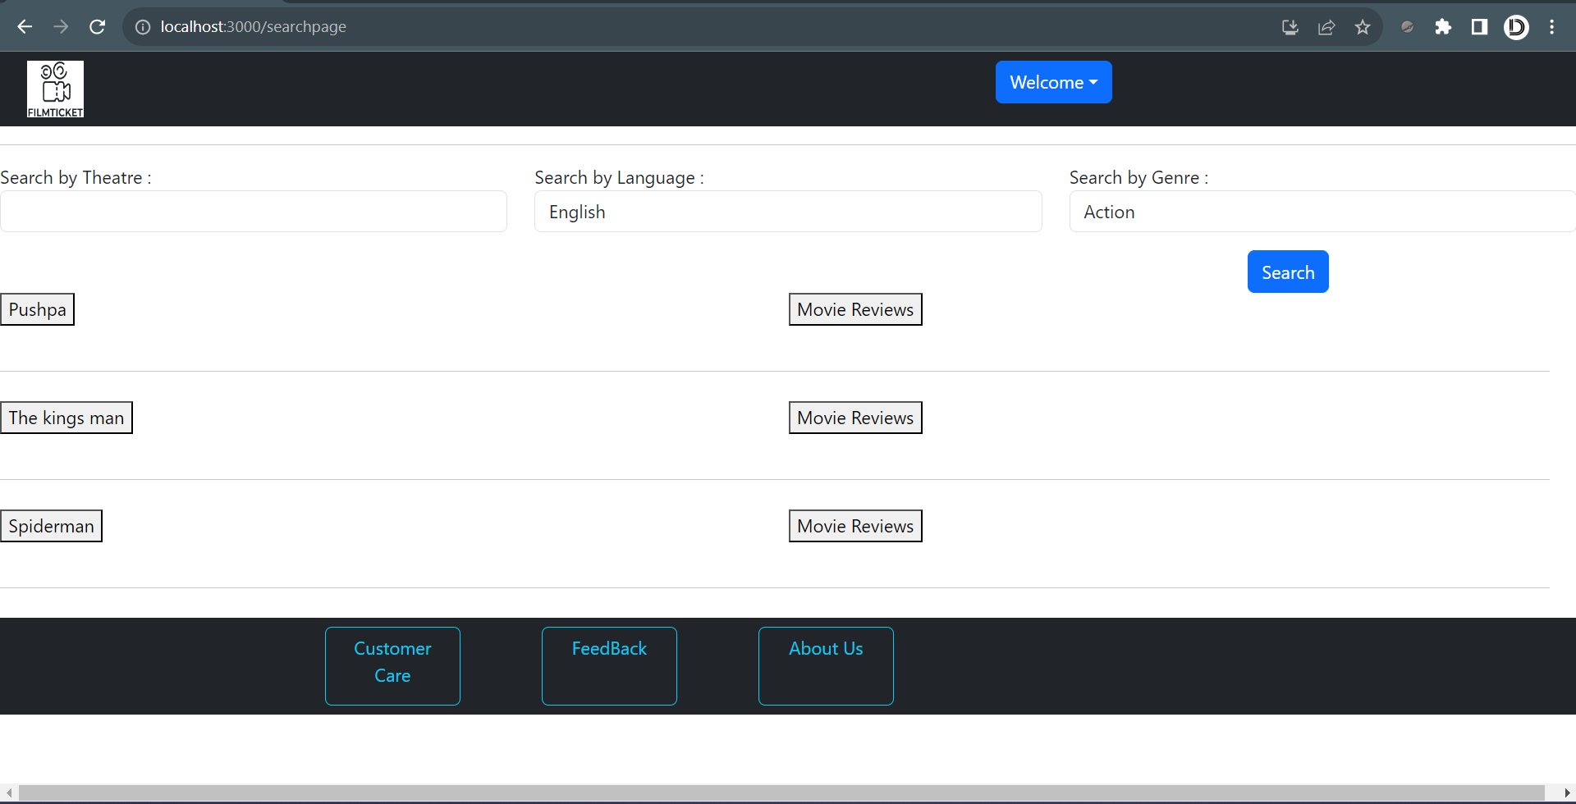
They select a preferred movie and showtime.

Slide 13
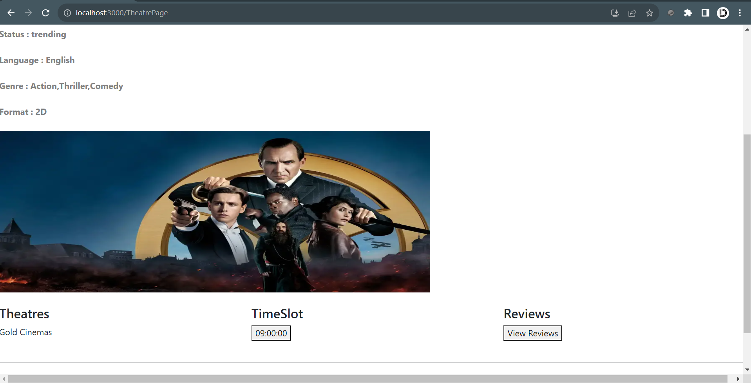
They select a preferred movie and showtime.

Slide 14
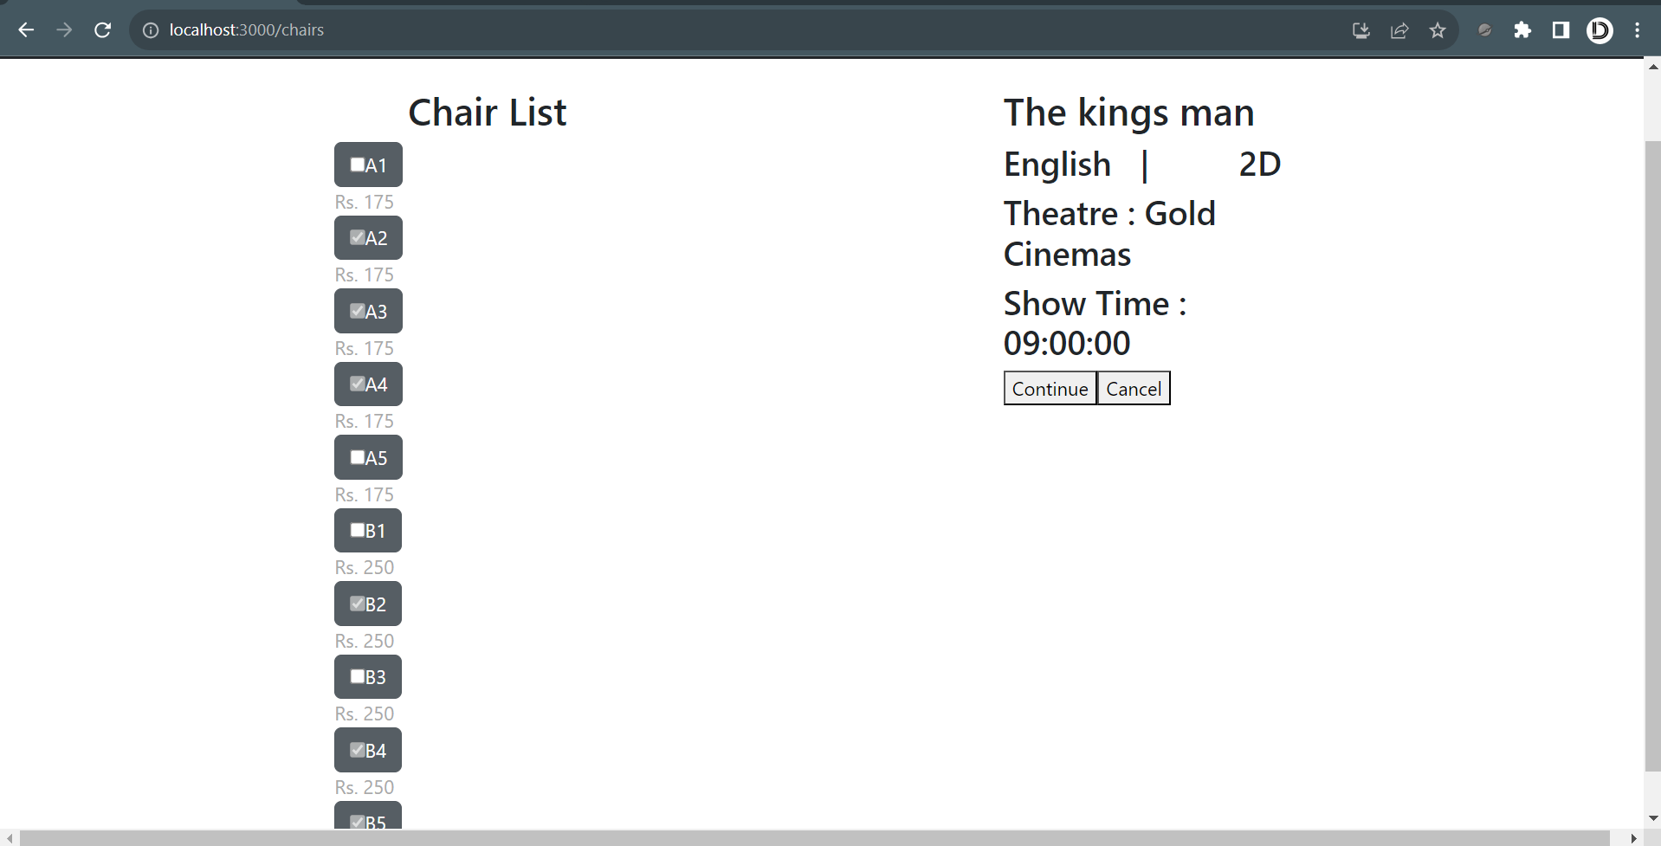
Customers choose seats from seats available

Slide 15
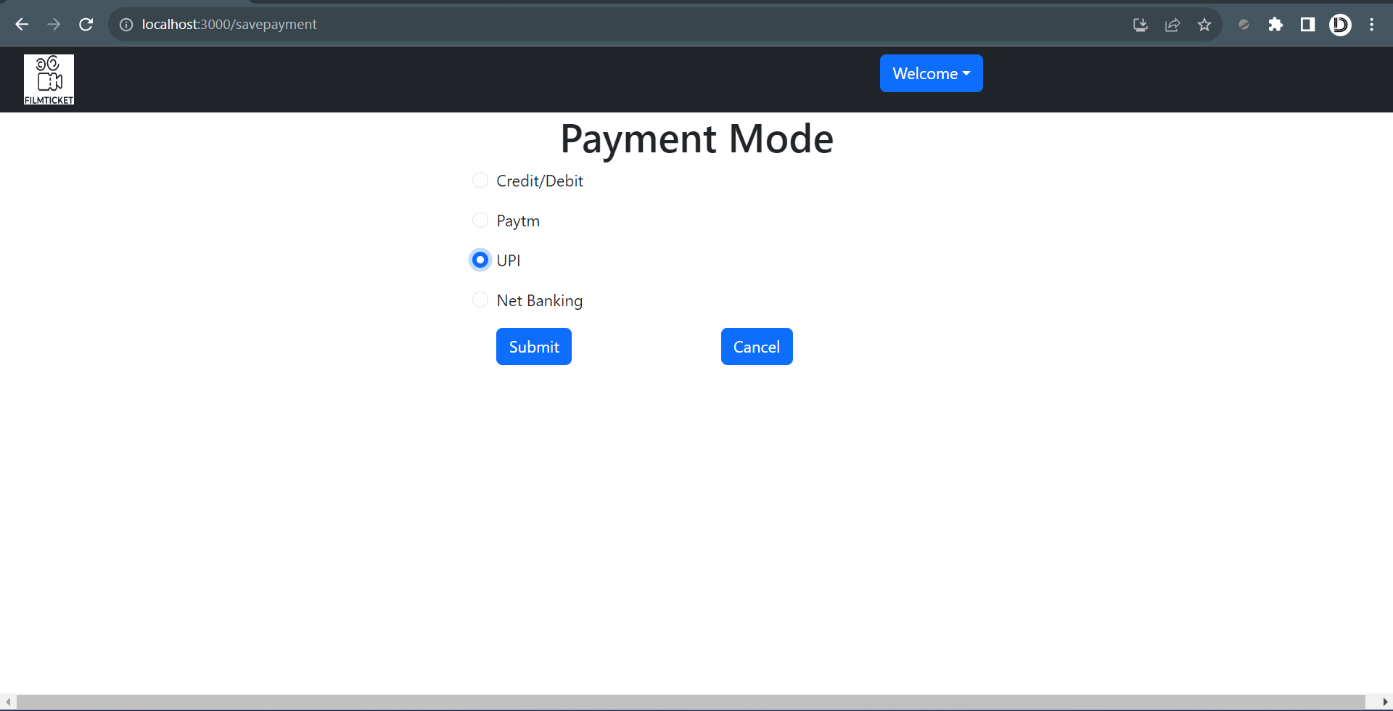
online payment is processed

Slide 16
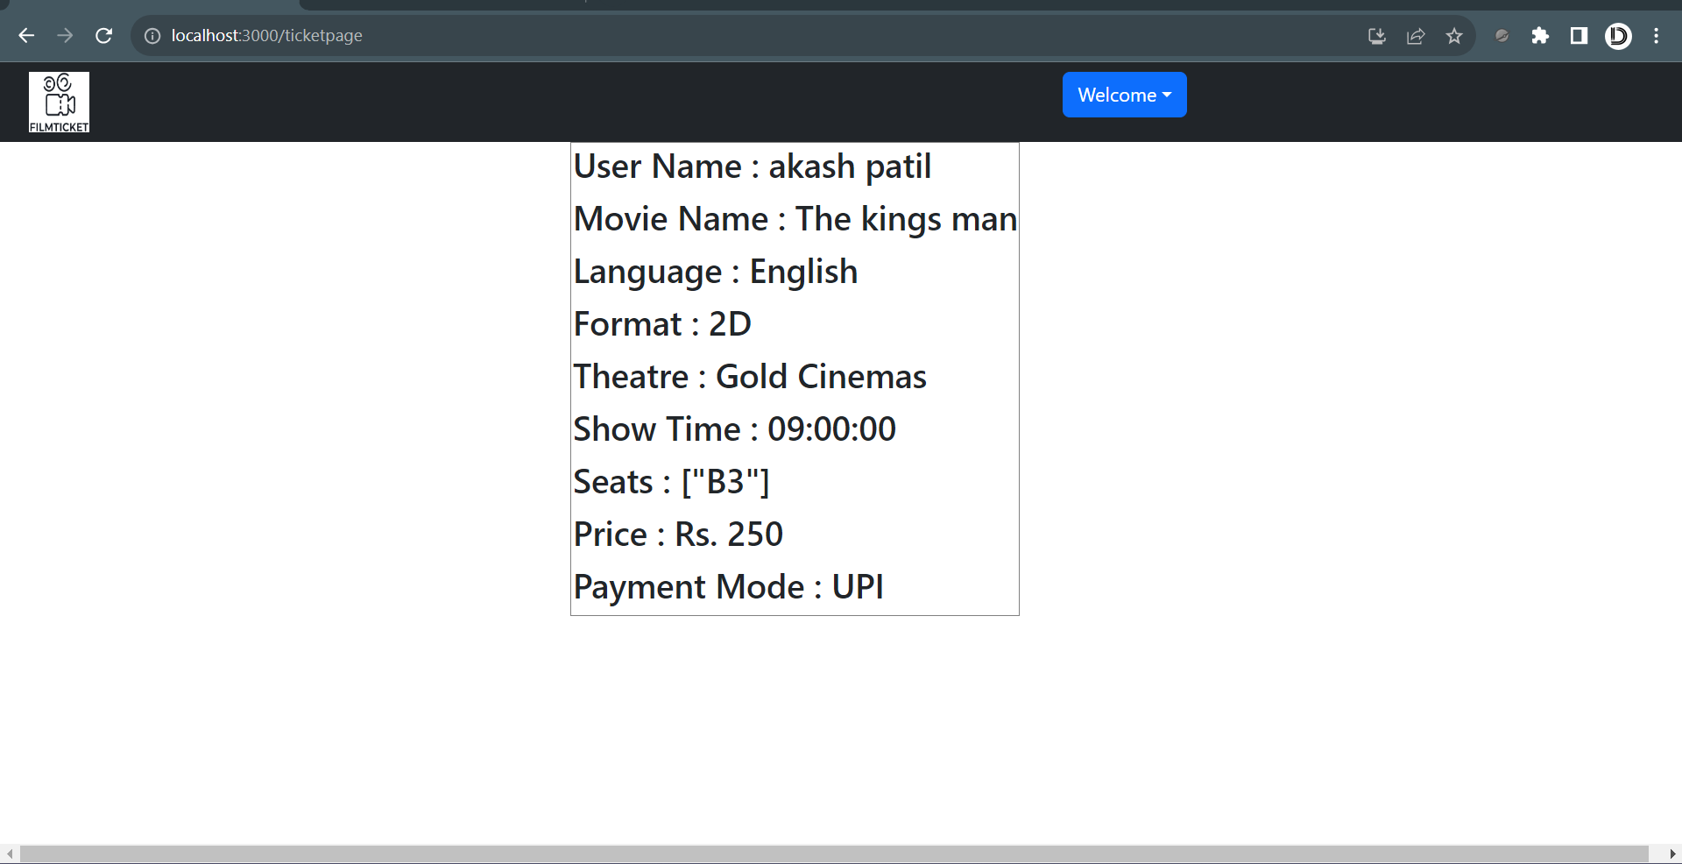
E-tickets are generated

Slide 17
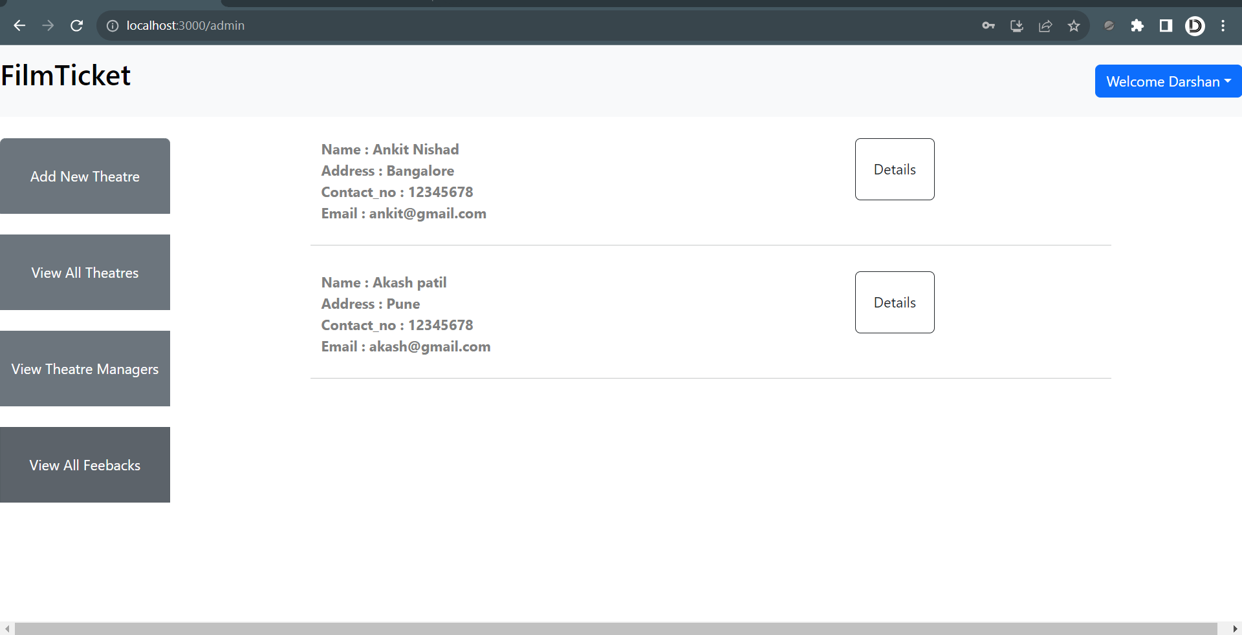
Admin Dashboard

Slide 18
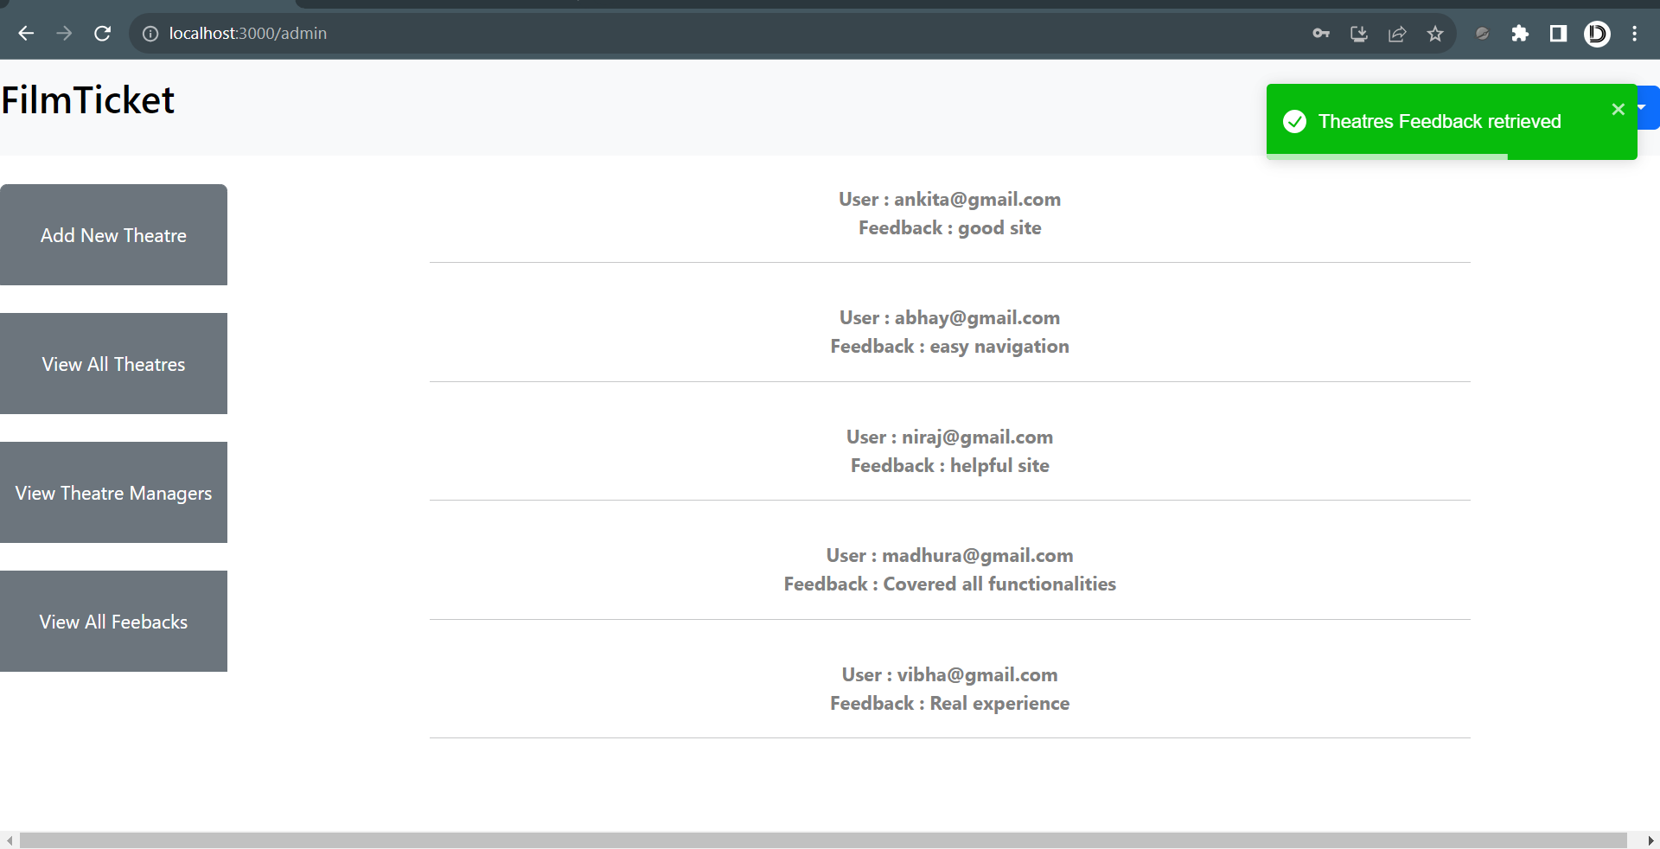
View Feedback

Slide 19
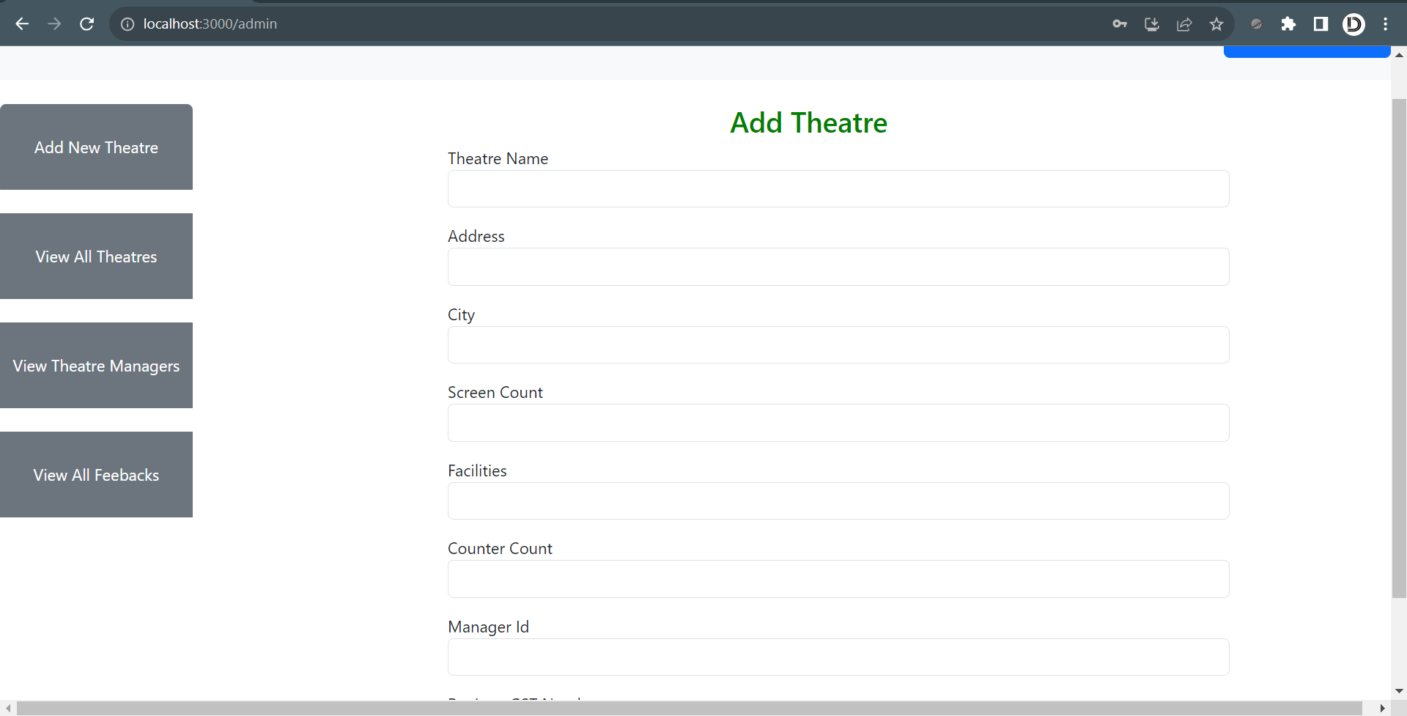
Add Theater

Slide 20
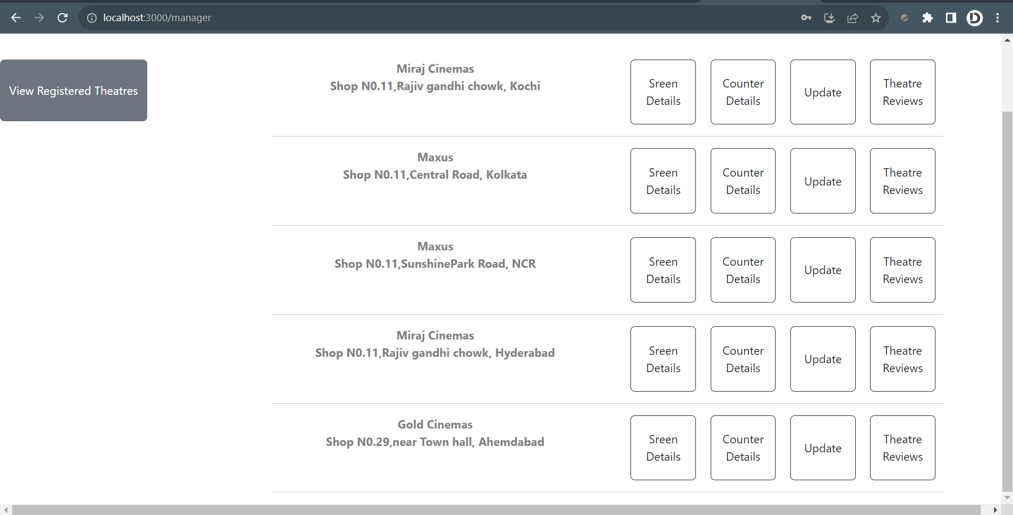
Theater Manager

Slide 21
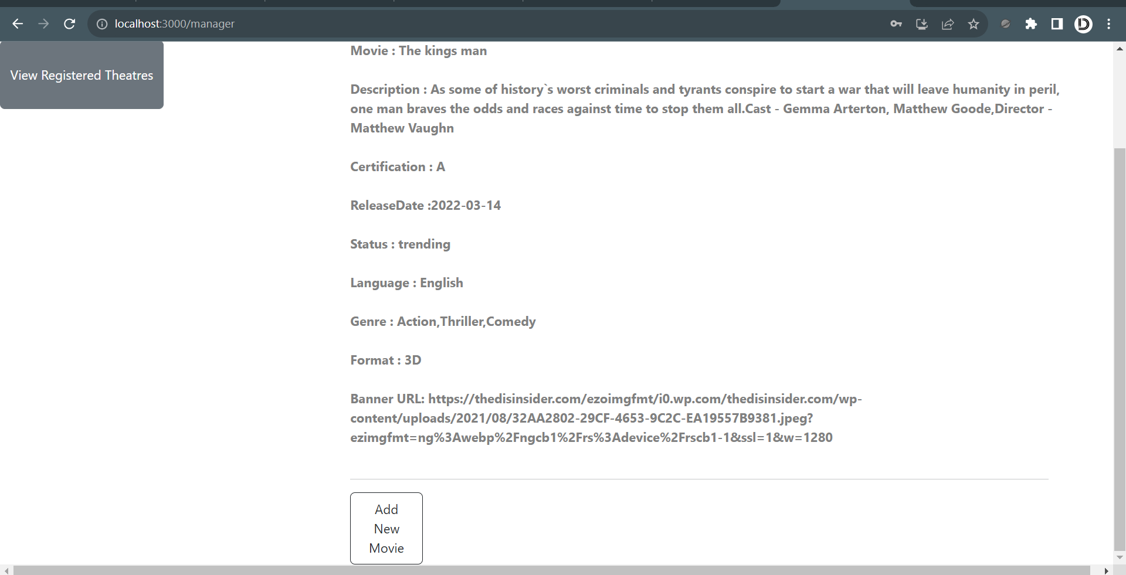
Add Movie

